Slide 1
Creating curriculums for Creativity
Rick Hall - Ignite!
ignitefutures.org.uk

Slide 2
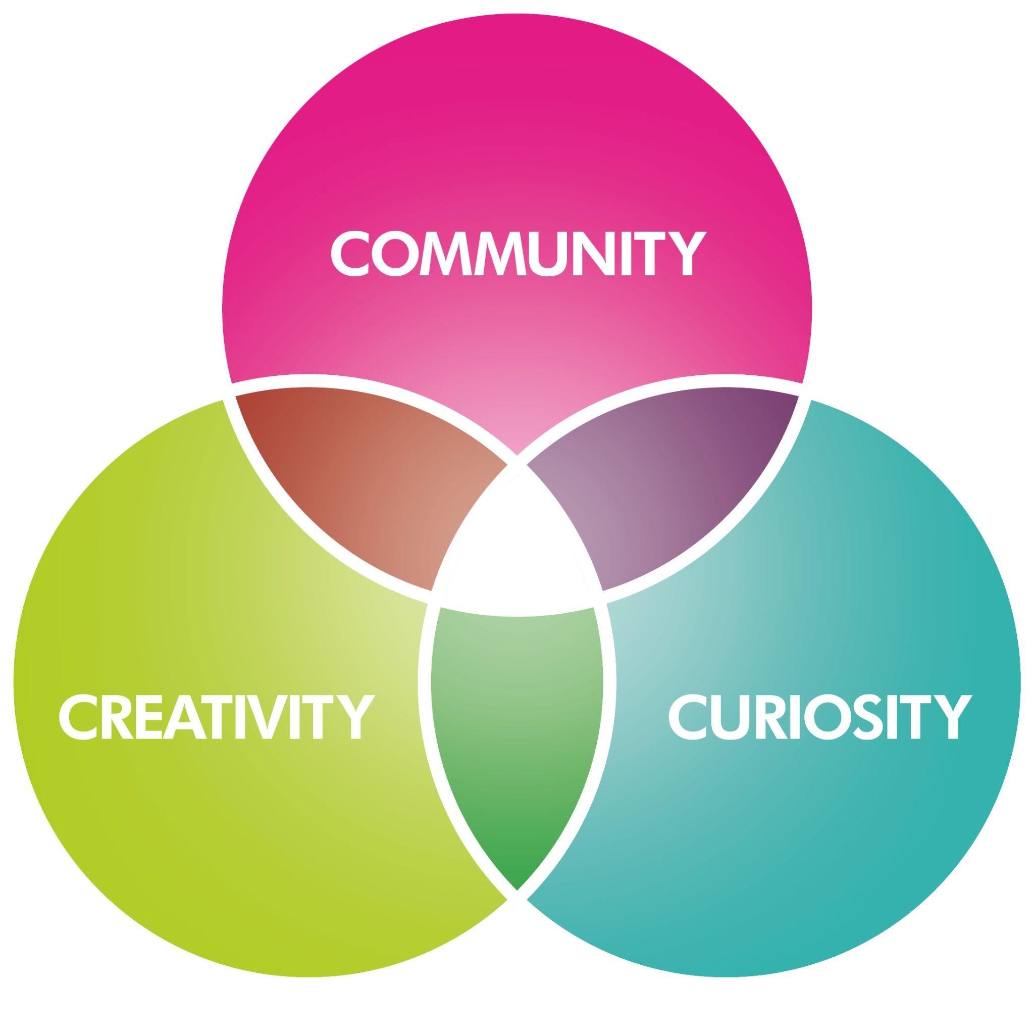
Ignite!’s core principles
Developing projects for communities to express their curiosity in creative ways

Slide 3
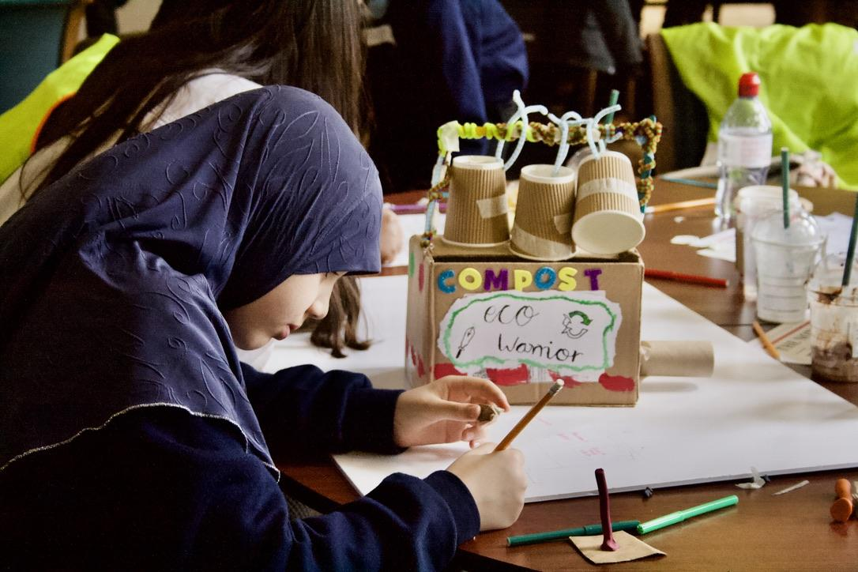
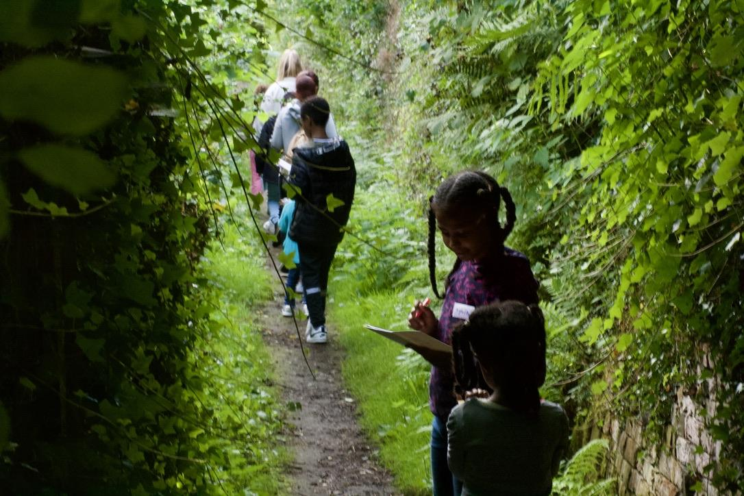
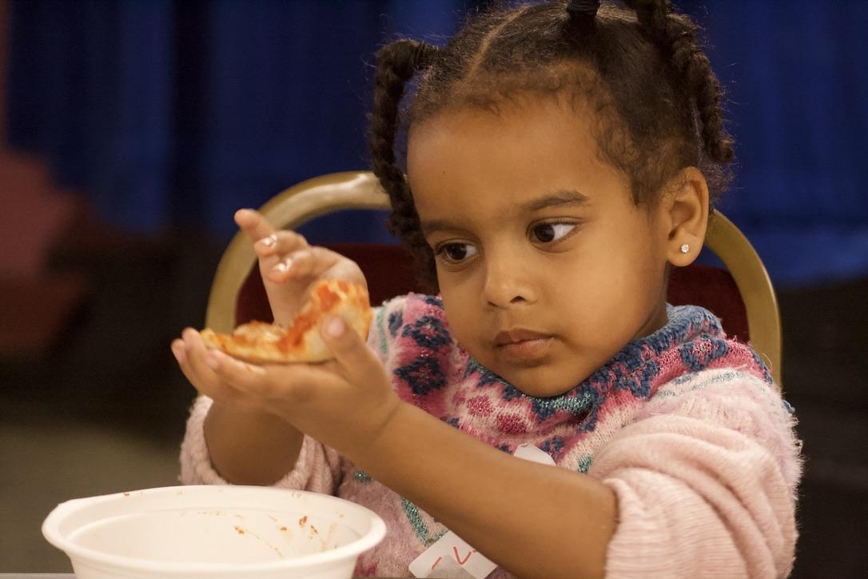
Learning to BE…
Scientists, Engineers, Choreographers,
Historians,
Composers,
Designers...
Revealing the curiosity and creativity that underpin all learning

Slide 4
Creativity Collaboratives Research Question:
How do we nurture our children’s innate creative capacity and sustain their curiosity about the world?
12 Nottingham schools,
36 residencies over 3 years

